Slide 1
Reason for Topic Changing
Previous Topic: FB-MF
Stands for: "Financial Bias Matrix Factorization"
Application: Limited to financial product recommendations (e.g., stocks, mutual funds).
Evaluation: Limited bias evaluation (only one dataset available).
Focus: Primarily financial rather than computer science or machine learning.
New Topic: CARMS-MF
Stands for: "Clustering Association Rule Mining Signal Matrix Factorization"
Application: Generalizable; can be applied to any dataset.
Evaluation: More robust; designed for testing on multiple datasets across various domains (e.g., movies, music, online shopping).
Focus: Computer science or machine learning.

Slide 2
Recommendation Systems (RecSys): Identifying the Gaps
Accuracy: Constant need for further accuracy improvements.
Cold-Start & Warm-Start Problem: Persistent challenge with new users [Polohakil et al., 2016].
Metadata Dependency: Many hybrid algorithms depend on user or item metadata, which is often unavailable or difficult to acquire [Alsalama, 2013, Polohakil et al., 2016].

Slide 3
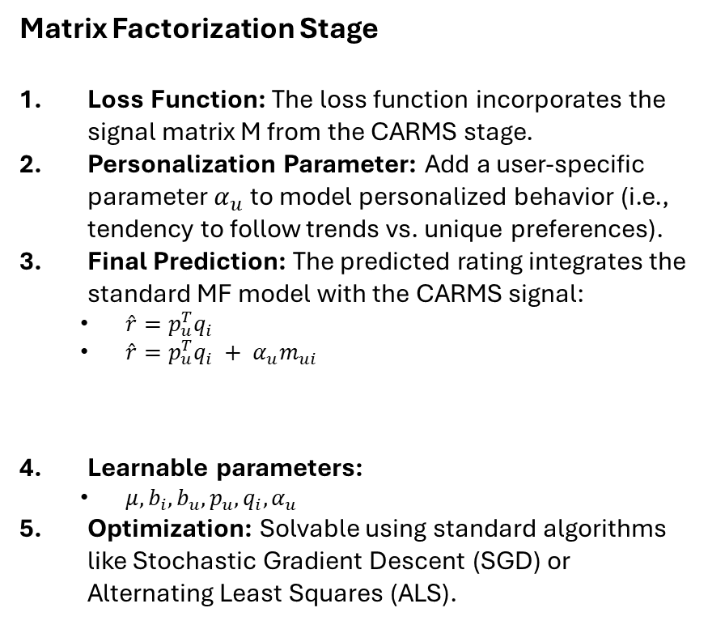
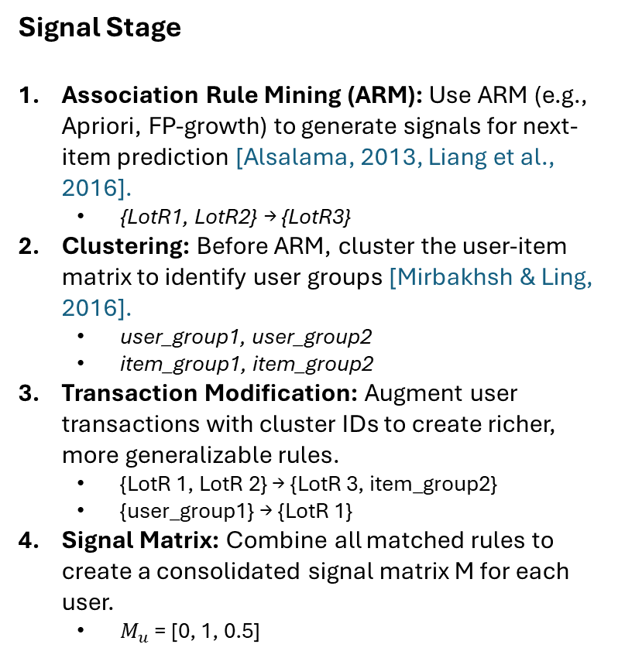
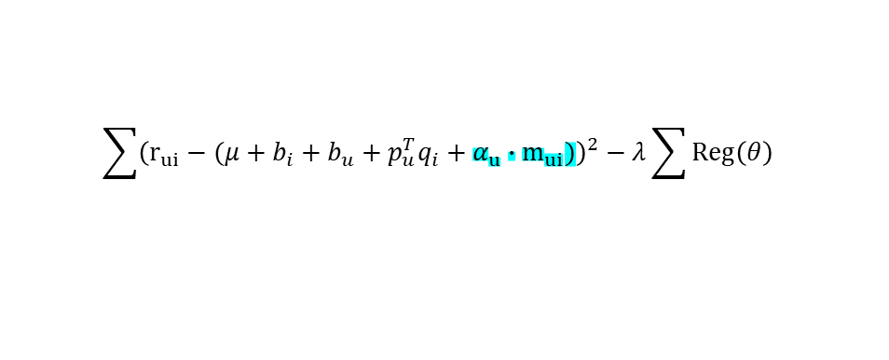
Our Proposal: CARMS-MF
Signal Stage
Association Rule Mining (ARM): Use ARM (e.g., Apriori, FP-growth) to generate signals for next-item prediction [Alsalama, 2013, Liang et al., 2016].
  {LotR1, LotR2} → {LotR3}
Clustering: Before ARM, cluster the user-item matrix to identify user groups [Mirbakhsh & Ling, 2016].
  user_group1, user_group2
  item_group1, item_group2
Transaction Modification: Augment user transactions with cluster IDs to create richer, more generalizable rules.
  {LotR 1, LotR 2} → {LotR 3, item_group2}
  {user_group1} → {LotR 1}
Signal Matrix: Combine all matched rules to create a consolidated signal matrix M for each user.
  $M_{u}$ = [0, 1, 0.5]
Matrix Factorization Stage
Loss Function: The loss function incorporates the signal matrix M from the CARMS stage.
Personalization Parameter: Add a user-specific parameter $α_{u}$ to model personalized behavior (i.e., tendency to follow trends vs. unique preferences).
Final Prediction: The predicted rating integrates the standard MF model with the CARMS signal:
  $\hat{r}=p_{u}^{T}q_{i}$
  $\hat{r}=p_{u}^{T}q_{i} + α_{u}m_{ui}$
Learnable parameters:
  $μ, b_{i},b_{u}, p_{u}, q_{i},α_{u}$
Optimization: Solvable using standard algorithms like Stochastic Gradient Descent (SGD) or Alternating Least Squares (ALS).
$$\sum{{\left(r_{ui}−(μ+b_{i}+b_{u}+p_{u}^{T}q_{i}+α_{u}∙m_{ui})\right)}^{2}−λ\sum{Reg\left(θ\right)}}$$

Slide 4
Related Work: Hybrid RecSys on ARM & CoFactor
Hybrid RecSys on ARM [Alsalama, 2013]
Method:
Combines Association Rule Mining (ARM) and Content-Based Filtering (CBF).
Process:
Items are distinguished as 'favorite' or 'non-favorite’.
'Favorite' items are mapped to ARM rules.
'Non-favorite' items use content-based filtering to map to the next 'favorite' item.
Gaps:
Metadata Dependency: Still a hybrid model that requires metadata for the CBF component.
Sparsity: Struggles with sparse ratings, which results in fewer association rules being found.
Co-Factor [Liang et al., 2016]
Method:
Uses Shifted Positive Pointwise Mutual Information function (SPPMI) to create an item-item signal matrix.
Process:
Calculates SPPMI score for item pairs
  {LotR 1} → {LotR 2}.
Adds this signal score to the loss function.
Factorizes both the user-item matrix (Y) and the item-item signal matrix (M) simultaneously.
Does not require any additional metadata.
Gaps:
Simple Rules: SPPMI is limited to detecting 1-to-1 item relationships (e.g., {A} → {B}), not complex, multi-item rules (e.g., {A, B} → {C}).
Cold-Start: Does not modify or augment transactions, so it doesn't fully address cold-start or warm-start problems.

Slide 5




























CARMS-MF: How It Works (Workflow)
1. Prepare Data: Pre-process user-item matrix.
5. Map Rules: Map rules back to users.
$$Y=\left[\begin{matrix}4 & 0 \\ 0 & 0 \\ 3 & 5\end{matrix}\right]$$
User 1:
$$\left\{User_group2, Item1, Item_group1\right\}$$
$→$Rule: 1, 2
$$Y^{T}=\left[\begin{matrix}4 & 0 & 3 \\ 0 & 0 & 5\end{matrix}\right]$$
User 2:
$$\left\{User_group1\right\}$$
Cold start user
$→$Rule: 4
User-item
Item-user
User 3:
$$\left\{User_group1,Item2, Item_group2\right\}$$
$→$Rule: 1,3, 4
2. Perform Clustering: Cluster users and items.
$$\left\{user_group1, user_gruop2\right\}$$
$$\left\{Item_group1, Item_gruop2\right\}$$
6. Create Signal Matrix: Build signal matrix.
User 1
User 2
User 3
Item 1
Item 3
$$M=\left[\begin{matrix}0 & 0.5+0.3 \\ 0 & 0.6 \\ 0.6+0.7 & 0.5\end{matrix}\right]$$
$$M_norm=\left[\begin{matrix}0 & 0.23 \\ 0 & 0.46 \\ 1 & 0\end{matrix}\right]$$
3. Augment Transactions: Add cluster IDs to transactions.
User 1:
$$\left\{Item1\right\}$$
$$\left\{User_group2, Item1, Item_group1\right\}$$
7. Formulate Loss Function: Define new loss function.
User 2:
$$\left\{User_group1\right\}$$
Cold start user
$$\sum{{\left(r_{ui}−(μ+b_{i}+b_{u}+p_{u}^{T}q_{i}+α_{u}∙m_{ui})\right)}^{2}−λ\sum{Reg\left(θ\right)}}$$
User 2:
$$\left\{Item2\right\}$$
$$\left\{User_group1,Item2, Item_group2\right\}$$
4. Mine Rules: Run FP-growth on augmented transactions.
8. Solve & Predict: Solve parameters and make predictions.
1. $\left\{User_group2\right\}$
$$→\left\{Item_group2\right\}$$
Confidence = 0.5
$$μ, b_{i},b_{u}, p_{u}, q_{i},α_{u}$$
2. $\left\{User_group2, item1\right\}$
$$→\left\{Item2\right\}$$
Confidence = 0.3
3. $\left\{Item2\right\}$
$$→\left\{Item1\right\}$$
Confidence = 0.6
4. $\left\{User_group1\right\}$
$$→\left\{Item1\right\}$$
Confidence = 0.7

Slide 6
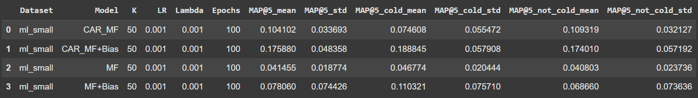
CARMS-MF: Preliminary Results

Slide 7
Timeline & Next Steps
No | Task | Due date
1 | Monthly progress updates with KBTG | 8 Nov
2 | Update thesis progress report for KMITL | 8 Nov
3 | Finalize implementation and experiment scripts | 8 Nov
4 | Complete writing for Chapters 1-4 | 22 Nov
5 | Discussions with advisor | 29 Nov
6 | Prepare for proposal defense | End of 2025

